Slide 1

Chapter Three
Problem Solving

Slide 2
Learning objectives.
3.1 Introduction
3.2 Structure of problem solving agent
3.3 Steps in problem solving by problem solving agent
3.4 Problem Formulation
3.5 State-space Representation
3.6 Problem formulation of the Eight Tile Puzzle
3.7 Problem formulation of the Water Jug Problem
3.8 Difference between Conventional Problem and AI Problem
3.9 Searching
3.10 Features of problem
3.11 Types of Searches
After this chapter , students will be able to :
Be familiar with terminology used in problem solving.
Read and analyse important historical and current problems addressing AI.
Demonstrate a strategy for using skills in problem solving over an extended period of time.
Monitor progress and adapt the strategy as necessary, to attain the quality of outcomes required when dealing with the problems.
Evaluate this overall strategy and present the outcomes from the work using a variety of methods.
Copyright © 2019 by Wiley India Pvt. Ltd., 4436/7, Ansari Road, Daryaganj, New Delhi-110002

Slide 3
Introduction
3.1 Introduction
3.2 Structure of problem solving agent
3.3 Steps in problem solving by problem solving agent
3.4 Problem Formulation
3.5 State-space Representation
3.6 Problem formulation of the Eight Tile Puzzle
3.7 Problem formulation of the Water Jug Problem
3.8 Difference between Conventional Problem and AI Problem
3.9 Searching
3.10 Features of problem
3.11 Types of Searches
In Artificial Intelligence (AI), the term problem solving is given to the analysis of how computers can be made to find solutions in well-circumscribed domains. Since puzzles and games have explicit rules, these are often used to explore ideas in AI (whether the insights thus gained will transfer to less formal domains is another issue). A good example of a problem-solving domain is the “Tower of Hanal” puzzle
Problem solving is defined as the way in which an agent finds a sequence of actions that achieves its goals, when no single action will do.
Problem formulation usually requires abstracting away real-world details to define a state space that can feasibly be explored. This step of abstraction is performed by an agent called as a problem-solving agent.
Copyright © 2019 by Wiley India Pvt. Ltd., 4436/7, Ansari Road, Daryaganj, New Delhi-110002

Slide 4
Structure of problem solving agent
3.1 Introduction
3.2 Structure of problem solving agent
3.3 Steps in problem solving by problem solving agent
3.4 Problem Formulation
3.5 State-space Representation
3.6 Problem formulation of the Eight Tile Puzzle
3.7 Problem formulation of the Water Jug Problem
3.8 Difference between Conventional Problem and AI Problem
3.9 Searching
3.10 Features of problem
3.11 Types of Searches
Goal state: A state that describes the objective that the agent is trying to achieve is called as the goal state of the agent.
Action: When there is a transition between the world states an action is said to be performed
Steps in problem solving by problem solving agent
Goal formulation: On the basis of the current situation and agent’s performance measure, it is the first step in problem solving. Agent’s task is to find out sequence of actions that will get it to the goal state. Goals help organise behaviour by limiting the objectives the agent is trying to achieve.
Problem formulation: It is a process of deciding what actions and states to consider given a goal.
Copyright © 2019 by Wiley India Pvt. Ltd., 4436/7, Ansari Road, Daryaganj, New Delhi-110002

Slide 5
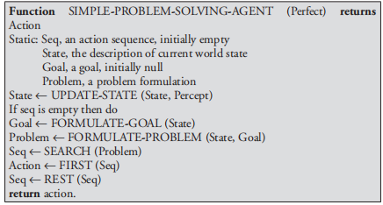
Steps in problem solving by problem solving agent
3.1 Introduction
3.2 Structure of problem solving agent
3.3 Steps in problem solving by problem solving agent
3.4 Problem Formulation
3.5 State-space Representation
3.6 Problem formulation of the Eight Tile Puzzle
3.7 Problem formulation of the Water Jug Problem
3.8 Difference between Conventional Problem and AI Problem
3.9 Searching
3.10 Features of problem
3.11 Types of Searches
3. Choosing the best sequence: An agent with several immediate options of unknown value can decide what to do by first examining different possible sequences of actions that lead to the states of known value and then choosing the best sequence.
Copyright © 2019 by Wiley India Pvt. Ltd., 4436/7, Ansari Road, Daryaganj, New Delhi-110002

Slide 6
Problem Formulation
3.1 Introduction
3.2 Structure of problem solving agent
3.3 Steps in problem solving by problem solving agent
3.4 Problem Formulation
3.5 State-space Representation
3.6 Problem formulation of the Eight Tile Puzzle
3.7 Problem formulation of the Water Jug Problem
3.8 Difference between Conventional Problem and AI Problem
3.9 Searching
3.10 Features of problem
3.11 Types of Searches
Problem formulation is the process of deciding what actions and states to consider given a goal.
ALGORITHM
Step 1: Analyse the problem to get the starting state and goal state.
Step 2: Find out the data about the starting state, goal state.
Step 3: Find out the production rules from initial database for progressing the problem to goal state.
Step 4: Select some rules from the set of rules that can be applied to data.
Step 5: Apply those rules to the initial state and proceed to get the next state.
Step 6: Determine some new generated states after applying the rules. Accordingly, make them as current state.
Step 7: Finally, achieve some information about the goal state from the recently used current state and get the goal state.
Step 8: Exit.
Copyright © 2019 by Wiley India Pvt. Ltd., 4436/7, Ansari Road, Daryaganj, New Delhi-110002

Slide 7
3.1 Introduction
3.2 Structure of problem solving agent
3.3 Steps in problem solving by problem solving agent
3.4 Problem Formulation
3.5 State-space Representation
3.6 Problem formulation of the Eight Tile Puzzle
3.7 Problem formulation of the Water Jug Problem
3.8 Difference between Conventional Problem and AI Problem
3.9 Searching
3.10 Features of problem
3.11 Types of Searches
State-space Representation
A state–space representation allows for the formal definition of a problem, which makes the movement from initial state to the goal state quite easily. So, we can say that various problems like planning, learning, theorem proving, etc., are all essentially search problems only.
State–space search is a process used in the field of computer science, including AI, in which successive configurations or states of an instance are considered, with the goal of finding a goal state with a desired property.
Copyright © 2019 by Wiley India Pvt. Ltd., 4436/7, Ansari Road, Daryaganj, New Delhi-110002

Slide 8
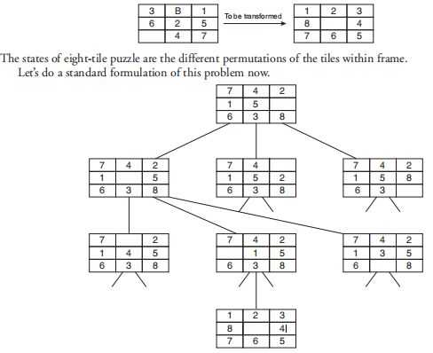
Problem formulation of the Eight Tile Puzzle
3.1 Introduction
3.2 Structure of problem solving agent
3.3 Steps in problem solving by problem solving agent
3.4 Problem Formulation
3.5 State-space Representation
3.6 Problem formulation of the Eight Tile Puzzle
3.7 Problem formulation of the Water Jug Problem
3.8 Difference between Conventional Problem and AI Problem
3.9 Searching
3.10 Features of problem
3.11 Types of Searches
The eight tile puzzle consist of a 3 by 3 (3 × 3) square frame board which holds eight movable tiles numbered 1 to 8. One square is empty, allowing the adjacent tiles to be shifted. The objective of the puzzle is to find a sequence of tile movements that leads from a starting configuration to a goal configuration.
Copyright © 2019 by Wiley India Pvt. Ltd., 4436/7, Ansari Road, Daryaganj, New Delhi-110002

Slide 9
Problem formulation of the Eight Tile Puzzle
3.1 Introduction
3.2 Structure of problem solving agent
3.3 Steps in problem solving by problem solving agent
3.4 Problem Formulation
3.5 State-space Representation
3.6 Problem formulation of the Eight Tile Puzzle
3.7 Problem formulation of the Water Jug Problem
3.8 Difference between Conventional Problem and AI Problem
3.9 Searching
3.10 Features of problem
3.11 Types of Searches
States: It specifies the location of each of the eight tiles and the blank in one of the nice squares.
Initial state: Any state can be designated as the initial state.
Goal: Many goal configurations are possible.
Legal moves (or state): They generate legal states that result from trying the four actions:
Blank moves left
Blank moves right
Blank moves up
Blank moves down
Path cost: Each step costs 1, so the path cost is the number of steps in the path.
Copyright © 2019 by Wiley India Pvt. Ltd., 4436/7, Ansari Road, Daryaganj, New Delhi-110002

Slide 10

Problem formulation of the Water Jug Problem
3.1 Introduction
3.2 Structure of problem solving agent
3.3 Steps in problem solving by problem solving agent
3.4 Problem Formulation
3.5 State-space Representation
3.6 Problem formulation of the Eight Tile Puzzle
3.7 Problem formulation of the Water Jug Problem
3.8 Difference between Conventional Problem and AI Problem
3.9 Searching
3.10 Features of problem
3.11 Types of Searches
Problem definition: You have given two jugs one with capacity of four gallons and other with capacity of three gallons none is having any measuring marks on it. There is the pump that can be used to fill water in jug.
Problem formulation Steps:
1. Describe the states
2. Identify the initial state
3. Identify the goal state
4. Identify set of rules (all possible actions)
5. Find the solution path in the state space
Copyright © 2019 by Wiley India Pvt. Ltd., 4436/7, Ansari Road, Daryaganj, New Delhi-110002

Slide 11
Problem formulation of the Water Jug Problem
3.1 Introduction
3.2 Structure of problem solving agent
3.3 Steps in problem solving by problem solving agent
3.4 Problem Formulation
3.5 State-space Representation
3.6 Problem formulation of the Eight Tile Puzzle
3.7 Problem formulation of the Water Jug Problem
3.8 Difference between Conventional Problem and AI Problem
3.9 Searching
3.10 Features of problem
3.11 Types of Searches
Solution: Now, we need to solve the problem such that there is two gallons of water in four gallons of jug. We will have to keep track of the amount of water in each of the jugs after we perform a particular action. Hence, we should represent the state such that it reflects the amount of water in each of the individual jugs.
Representation of state: For the aforementioned problem, the state can be described as ordered pair of integer (x, y) such that ‘x’ is the amount of water in four gallon of jug, hence ‘x’ can take values 0, 1, 2, 3, 4 gallons. (Note: Since ‘x’ is the amount of water in four gallon of jug, the jug can be empty, i.e. has 0 gallonsof water or can have 1/2/3/4 gallons of water, respectively). ‘y’ is the amount of water in three gallons of jug. Similarly y can take values as 0, 1, 2, 3 ...
Copyright © 2019 by Wiley India Pvt. Ltd., 4436/7, Ansari Road, Daryaganj, New Delhi-110002

Slide 12
Problem formulation of the Water Jug Problem
3.1 Introduction
3.2 Structure of problem solving agent
3.3 Steps in problem solving by problem solving agent
3.4 Problem Formulation
3.5 State-space Representation
3.6 Problem formulation of the Eight Tile Puzzle
3.7 Problem formulation of the Water Jug Problem
3.8 Difference between Conventional Problem and AI Problem
3.9 Searching
3.10 Features of problem
3.11 Types of Searches
Initial state: Initially, we assume that both the jugs are empty. That is both the jugs contain zero gallons of water. This initial situation (also called as initial state) can be represented using state representation notation as follows:
SI = (0, 0) Note that initial state is represented by SI.
Goal state: We need two gallons of water in four gallons of jug as the goal but there can be any amount of water in three gallons of jug. Hence goal state is the set of states.
SG = {(2, 0), (2, 1), (2, 2), (2, 3)}
This notation indicates that there must be two gallons of water in four gallons of jug but there can be 0/1/2/3 gallons of water in three gallons of jug which we are not concerned. Hence, goal state represented by SG is set of states as shown. Hence, as the goal the agent can achieve any one of the states that belongs to this set.
Copyright © 2019 by Wiley India Pvt. Ltd., 4436/7, Ansari Road, Daryaganj, New Delhi-110002

Slide 13
Problem formulation of the Water Jug Problem
3.1 Introduction
3.2 Structure of problem solving agent
3.3 Steps in problem solving by problem solving agent
3.4 Problem Formulation
3.5 State-space Representation
3.6 Problem formulation of the Eight Tile Puzzle
3.7 Problem formulation of the Water Jug Problem
3.8 Difference between Conventional Problem and AI Problem
3.9 Searching
3.10 Features of problem
3.11 Types of Searches
Set of rules: Now, we write set of rules that will be applied to current state so as to change the current state and go to the next state. To write these set of rules one has to simply think of all possible combinations that can occur,
Rule 1: Fill in 4G Jug completely
(x, y) → (4, y) if (x < 4)
Rule 2: Fill in 3G Jug completely
(x, y) → (x, e) if (y < 3)
Rule 3: Pour some water from 4G Jug to ground
(x, y) → (x−d, y) if (x > 0)
Rule 4: Pour some water from 3G jug to ground
(x, y) → (x, y−d) if (y > 0)
Rule 5: Empty 4G jug
(x, y) → (0, y) if (x > 0)
Copyright © 2019 by Wiley India Pvt. Ltd., 4436/7, Ansari Road, Daryaganj, New Delhi-110002

Slide 14
Problem formulation of the Water Jug Problem
3.1 Introduction
3.2 Structure of problem solving agent
3.3 Steps in problem solving by problem solving agent
3.4 Problem Formulation
3.5 State-space Representation
3.6 Problem formulation of the Eight Tile Puzzle
3.7 Problem formulation of the Water Jug Problem
3.8 Difference between Conventional Problem and AI Problem
3.9 Searching
3.10 Features of problem
3.11 Types of Searches
Rule 6: Empty 3G jug
(x, y) → (x, 0) if (y > 0)
Rule 7: Pour some water from 3G jug to 4G jug until 4G jug is FULL
(x, y) → (4, y – (4 – x)) if (y > 0) and (x + y) ≥ 4
Rule 8: Pour some water from 4G jug to 3G jug until 3G jug is FULL
(x, y) → (x – (3 – y), 3) if (x > 0) and (x + y) ≥ 3
Rule 9: Pour all water from 3G jug to 4G jug
(x, y) → (x + y, 0) if (y > 0) and (x + y) ≤ 4
Rule 10: Pour all water from 4G jug to 3G jug
(x, y) → (0, x + y) if (x > 0) and (x + y) ≤ 3
Copyright © 2019 by Wiley India Pvt. Ltd., 4436/7, Ansari Road, Daryaganj, New Delhi-110002

Slide 15
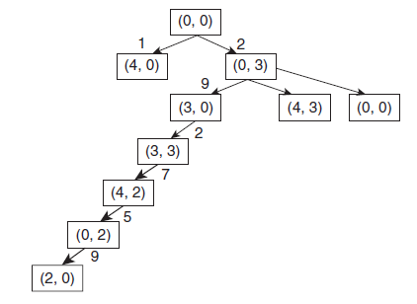
Problem formulation of the Water Jug Problem
3.1 Introduction
3.2 Structure of problem solving agent
3.3 Steps in problem solving by problem solving agent
3.4 Problem Formulation
3.5 State-space Representation
3.6 Problem formulation of the Eight Tile Puzzle
3.7 Problem formulation of the Water Jug Problem
3.8 Difference between Conventional Problem and AI Problem
3.9 Searching
3.10 Features of problem
3.11 Types of Searches
we will apply these set of rules to the initial state to generate the goal state. These set of rules will be applied to each state until we reach the goal. Hence, we generate a tree which represents all the possible states in the problem, and this is called as state space. In a state space, we will find a path to the goal this is called a solution path. Solution path is found from state space by state space search. This approach of solution is called as state-space approach. Solution Tree: To represent all the possible states in the state space.
Copyright © 2019 by Wiley India Pvt. Ltd., 4436/7, Ansari Road, Daryaganj, New Delhi-110002

Slide 16
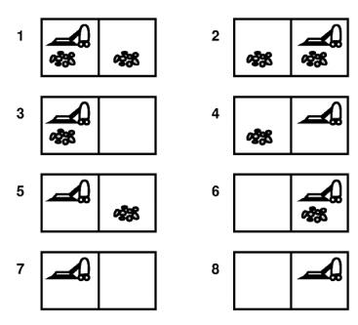
Vacuum world state
3.1 Introduction
3.2 Structure of problem solving agent
3.3 Steps in problem solving by problem solving agent
3.4 Problem Formulation
3.5 State-space Representation
3.6 Problem formulation of the Eight Tile Puzzle
3.7 Problem formulation of the b) Vacuum Cleaner Problem
3.8 Difference between Conventional Problem and AI Problem
3.9 Searching
3.10 Features of problem
3.11 Types of Searches
states?
Initial state?
actions?
goal test?
path cost?
Notes:
Our vacuum cleaner world that we have looked at earlier.

Slide 17
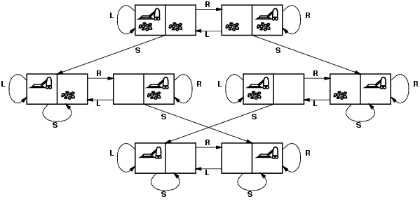
Vacuum world state space graph
3.1 Introduction
3.2 Structure of problem solving agent
3.3 Steps in problem solving by problem solving agent
3.4 Problem Formulation
3.5 State-space Representation
3.6 Problem formulation of the Eight Tile Puzzle
3.7 Problem formulation of the b) Vacuum Cleaner Problem
3.8 Difference between Conventional Problem and AI Problem
3.9 Searching
3.10 Features of problem
3.11 Types of Searches
states?
Initial state?
actions?
goal test?
path cost?
Notes:
Our vacuum cleaner world that we have looked at earlier.

Slide 18
Vacuum world state space graph
3.1 Introduction
3.2 Structure of problem solving agent
3.3 Steps in problem solving by problem solving agent
3.4 Problem Formulation
3.5 State-space Representation
3.6 Problem formulation of the Eight Tile Puzzle
3.7 Problem formulation of the b) Vacuum Cleaner Problem
3.8 Difference between Conventional Problem and AI Problem
3.9 Searching
3.10 Features of problem
3.11 Types of Searches
states? integer dirt and robot location
Initial state? Dirt in both locations and the vacuum cleaner in one of them
actions? Left, Right, Suck
goal test? no dirt at all locations
path cost? 1 per action
Notes:
Our vacuum cleaner world that we have looked at earlier.

Slide 19
Missionaries and Cannibals
3.1 Introduction
3.2 Structure of problem solving agent
3.3 Steps in problem solving by problem solving agent
3.4 Problem Formulation
3.5 State-space Representation
3.6 Problem formulation of the Eight Tile Puzzle
3.7 Problem formulation of the c) Missionaries and Cannibals
3.8 Difference between Conventional Problem and AI Problem
3.9 Searching
3.10 Features of problem
3.11 Types of Searches
Three missionaries and three cannibals are on one side of a river that they wish to cross.
A boat is available that can hold at most two people and at least one.
You must never leave a group of missionaries outnumbered by cannibals on the same bank.
Find an action sequence that brings everyone safely to the opposite bank.
Notes:
Our vacuum cleaner world that we have looked at earlier.

Slide 20
Missionaries and Cannibals
3.1 Introduction
3.2 Structure of problem solving agent
3.3 Steps in problem solving by problem solving agent
3.4 Problem Formulation
3.5 State-space Representation
3.6 Problem formulation of the Eight Tile Puzzle
3.7 Problem formulation of the c) Missionaries and Cannibals
3.8 Difference between Conventional Problem and AI Problem
3.9 Searching
3.10 Features of problem
3.11 Types of Searches
Goal: Move all the missionaries and cannibals across the river.
Constraint: Missionaries can never be outnumbered by cannibals on either side of river, or else the missionaries are killed.
State: configuration of missionaries and cannibals and boat on each side of river.
Initial State: 3 missionaries, 3 cannibals and the boat are on the near bank
Operators: Move boat containing some set of occupants across the river (in either direction) to the other side.

Slide 21
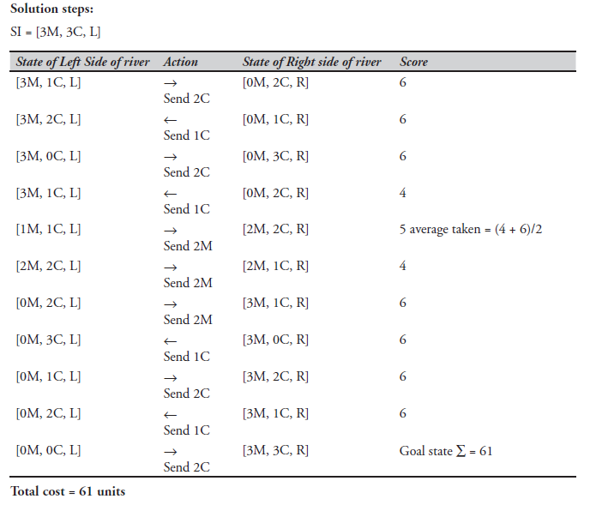
3.1 Introduction
3.2 Structure of problem solving agent
3.3 Steps in problem solving by problem solving agent
3.4 Problem Formulation
3.5 State-space Representation
3.6 Problem formulation of the Eight Tile Puzzle
3.7 Problem formulation of the c) Missionaries and Cannibals
3.8 Difference between Conventional Problem and AI Problem
3.9 Searching
3.10 Features of problem
3.11 Types of Searches

Slide 22
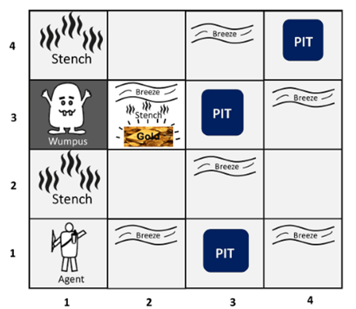
Wumpus World Problem
3.1 Introduction
3.2 Structure of problem solving agent
3.3 Steps in problem solving by problem solving agent
3.4 Problem Formulation
3.5 State-space Representation
3.6 Problem formulation of the Eight Tile Puzzle
3.7 Problem formulation of the d) Wumpus World Problem
3.8 Difference between Conventional Problem and AI Problem
3.9 Searching
3.10 Features of problem
3.11 Types of Searches
Problem definition: A wumpus world problem comprises of a 4 × 4 grid with the heap of gold in one of the squares. An agent enters the grid and the aim is to find the heap of gold.
The Hurdles: The grid has live wumpus in one of the squares. The agent is eaten up by the wumpus if enters the wumpus square also there are pits in some square and agent dies falling into pits the agent enters any of these squares. Also, there exist walls in between some of the cells.

Slide 23
Agent in a Wumpus world: Percepts
3.1 Introduction
3.2 Structure of problem solving agent
3.3 Steps in problem solving by problem solving agent
3.4 Problem Formulation
3.5 State-space Representation
3.6 Problem formulation of the Eight Tile Puzzle
3.7 Problem formulation of the d) Wumpus World Problem
3.8 Difference between Conventional Problem and AI Problem
3.9 Searching
3.10 Features of problem
3.11 Types of Searches
The agent perceives
a stench in the square containing the wumpus and in the adjacent squares (not diagonally)
a breeze in the squares adjacent to a pit
a glitter in the square where the gold is
a bump, if it walks into a wall
a woeful scream everywhere in the cave, if the wumpus is killed
The percepts will be given as a five-symbol list:
If there is a stench, and a breeze, but no glitter, no bump, and no scream, the percept is
[Stench, Breeze, None, None, None]
The agent can not perceive its own location.

Slide 24
The actions of the agent in Wumpus game are:
3.1 Introduction
3.2 Structure of problem solving agent
3.3 Steps in problem solving by problem solving agent
3.4 Problem Formulation
3.5 State-space Representation
3.6 Problem formulation of the Eight Tile Puzzle
3.7 Problem formulation of the d) Wumpus World Problem
3.8 Difference between Conventional Problem and AI Problem
3.9 Searching
3.10 Features of problem
3.11 Types of Searches
go forward
turn right 90 degrees
turn left 90 degrees
grab means pick up an object that is in the same square as the agent
shoot means fire an arrow in a straight line in the direction the agent is looking.
The arrow continues until it either hits and kills the wumpus or hits the wall.
The agent has only one arrow.
Only the first shot has any effect.
climb is used to leave the cave.
Only effective in start field.
die, if the agent enters a square with a pit or a live wumpus.
(No take-backs!)

Slide 25
3.1 Introduction
3.2 Structure of problem solving agent
3.3 Steps in problem solving by problem solving agent
3.4 Problem Formulation
3.5 State-space Representation
3.6 Problem formulation of the Eight Tile Puzzle
3.7 Problem formulation of the d) Wumpus World Problem
3.8 Difference between Conventional Problem and AI Problem
3.9 Searching
3.10 Features of problem
3.11 Types of Searches
The agent’s goal
The agent’s goal is to find the gold and bring it back to the start as quickly as possible, without getting killed.
1000 points reward for climbing out of the cave with the gold
1 point deducted for every action taken
10000 points penalty for getting killed

Slide 26
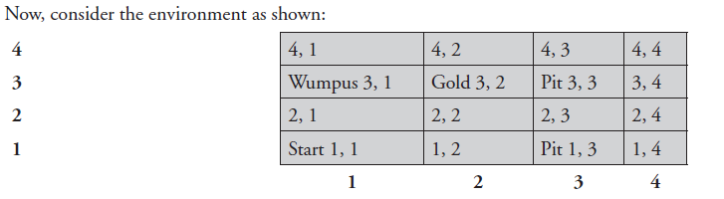
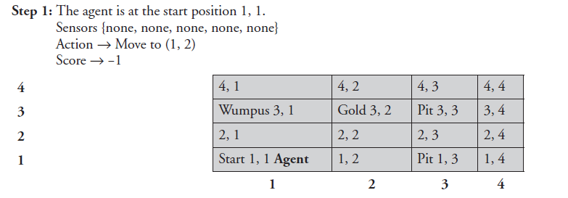
The Wumpus agent’s first step
3.1 Introduction
3.2 Structure of problem solving agent
3.3 Steps in problem solving by problem solving agent
3.4 Problem Formulation
3.5 State-space Representation
3.6 Problem formulation of the Eight Tile Puzzle
3.7 Problem formulation of the d) Wumpus World Problem
3.8 Difference between Conventional Problem and AI Problem
3.9 Searching
3.10 Features of problem
3.11 Types of Searches
For the grid shown earlier, we explore it till the agent reaches the square-containing gold and give the final solutions and steps.

Slide 27
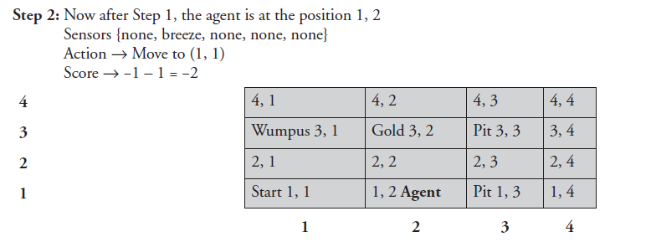
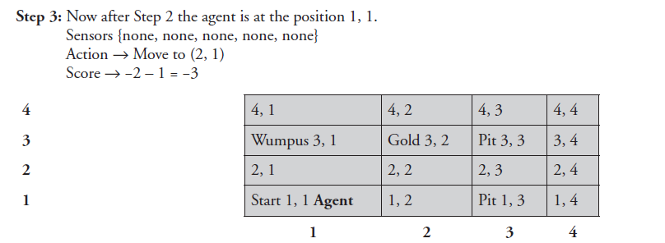
3.1 Introduction
3.2 Structure of problem solving agent
3.3 Steps in problem solving by problem solving agent
3.4 Problem Formulation
3.5 State-space Representation
3.6 Problem formulation of the Eight Tile Puzzle
3.7 Problem formulation of the d) Wumpus World Problem
3.8 Difference between Conventional Problem and AI Problem
3.9 Searching
3.10 Features of problem
3.11 Types of Searches

Slide 28
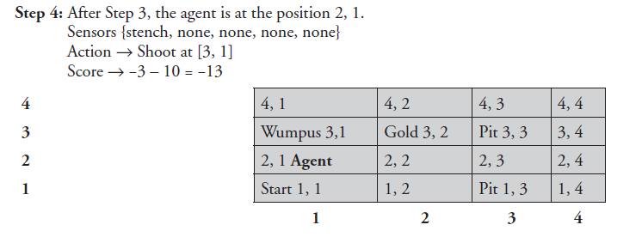
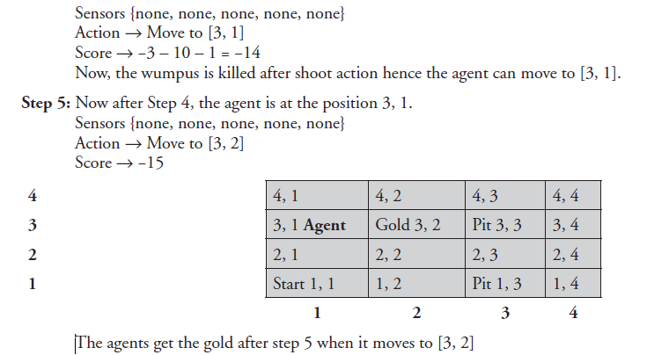
3.1 Introduction
3.2 Structure of problem solving agent
3.3 Steps in problem solving by problem solving agent
3.4 Problem Formulation
3.5 State-space Representation
3.6 Problem formulation of the Eight Tile Puzzle
3.7 Problem formulation of the d) Wumpus World Problem
3.8 Difference between Conventional Problem and AI Problem
3.9 Searching
3.10 Features of problem
3.11 Types of Searches

Slide 29

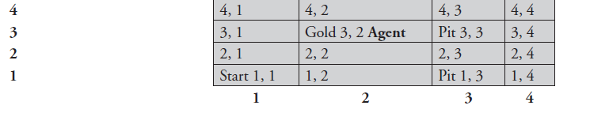
Final Goal
3.1 Introduction
3.2 Structure of problem solving agent
3.3 Steps in problem solving by problem solving agent
3.4 Problem Formulation
3.5 State-space Representation
3.6 Problem formulation of the Eight Tile Puzzle
3.7 Problem formulation of the d) Wumpus World Problem
3.8 Difference between Conventional Problem and AI Problem
3.9 Searching
3.10 Features of problem
3.11 Types of Searches

Slide 30
Cryptarithmetic
3.1 Introduction
3.2 Structure of problem solving agent
3.3 Steps in problem solving by problem solving agent
3.4 Problem Formulation
3.5 State-space Representation
3.6 Problem formulation of the Eight Tile Puzzle
3.7 Problem formulation of the e) Crypt Arithmetic Problem
3.8 Difference between Conventional Problem and AI Problem
3.9 Searching
3.10 Features of problem
3.11 Types of Searches
Find an assignment of digits (0, ..., 9) to letters so that a given arithmetic expression is true. examples: SEND + MORE = MONEY and
FORTY Solution: 29786
+ TEN 850
+ TEN 850
----- -----
SIXTY 31486
F=2, O=9, R=7, etc.

Slide 31
Cryptarithmetic
3.1 Introduction
3.2 Structure of problem solving agent
3.3 Steps in problem solving by problem solving agent
3.4 Problem Formulation
3.5 State-space Representation
3.6 Problem formulation of the Eight Tile Puzzle
3.7 Problem formulation of the e) Crypt Arithmetic Problem
3.8 Difference between Conventional Problem and AI Problem
3.9 Searching
3.10 Features of problem
3.11 Types of Searches
Find an assignment of digits to letters so that a given arithmetic expression is true. examples: SEND + MORE = MONEY and
FORTY Solution: 29786
+ TEN 850
+ TEN 850
----- -----
SIXTY 31486
F=2, O=9, R=7, etc.
State: mapping from letters to digits
Initial State: empty mapping
Operators: assign a digit to a letter
Goal Test: whether the expression is true given the complete mapping
Note: In this problem, the solution is NOT a sequence of actions that transforms the initial state into the goal state; rather, the solution is a goal node that includes an assignment of a digit to each letter in the given problem.

Slide 32
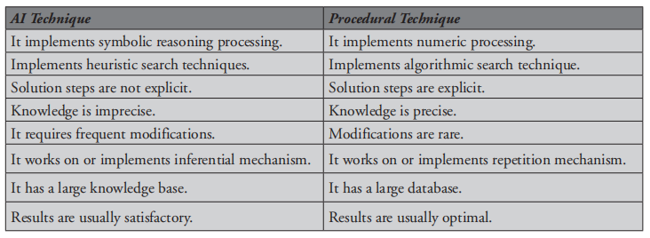
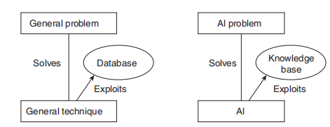
Difference between Conventional Problem and AI Problem
3.1 Introduction
3.2 Structure of problem solving agent
3.3 Steps in problem solving by problem solving agent
3.4 Problem Formulation
3.5 State-space Representation
3.6 Problem formulation of the Eight Tile Puzzle
3.7 Problem formulation of the Water Jug Problem
3.8 Difference between Conventional Problem and AI Problem
3.9 Searching
3.10 Features of problem
3.11 Types of Searches
Copyright © 2019 by Wiley India Pvt. Ltd., 4436/7, Ansari Road, Daryaganj, New Delhi-110002

Slide 33
Searching
3.1 Introduction
3.2 Structure of problem solving agent
3.3 Steps in problem solving by problem solving agent
3.4 Problem Formulation
3.5 State-space Representation
3.6 Problem formulation of the Eight Tile Puzzle
3.7 Problem formulation of the Water Jug Problem
3.8 Difference between Conventional Problem and AI Problem
3.9 Searching
3.10 Features of problem
3.11 Types of Searches
Given the representation of a domain in the terms just described, a number of techniques can be applied to find solution.
Generate and Test
Random Search
Search Spaces
Copyright © 2019 by Wiley India Pvt. Ltd., 4436/7, Ansari Road, Daryaganj, New Delhi-110002

Slide 34
Assumptions in Basic Search
3.1 Introduction
3.2 Structure of problem solving agent
3.3 Steps in problem solving by problem solving agent
3.4 Problem Formulation
3.5 State-space Representation
3.6 Problem formulation of the Eight Tile Puzzle
3.7 Problem formulation of the Water Jug Problem
3.8 Difference between Conventional Problem and AI Problem
3.9 Searching
3.10 Features of problem
3.11 Types of Searches
The world is static
The world is discretizable
The world is observable
The actions are deterministic
But many of these assumptions can be
removed, and search still remains an
important problem-solving tool.

Slide 35
Searching the state
3.1 Introduction
3.2 Structure of problem solving agent
3.3 Steps in problem solving by problem solving agent
3.4 Problem Formulation
3.5 State-space Representation
3.6 Problem formulation of the Eight Tile Puzzle
3.7 Problem formulation of the Water Jug Problem
3.8 Difference between Conventional Problem and AI Problem
3.9 Searching
3.10 Features of problem
3.11 Types of Searches
So far we have talked about how a problem can be looked at so as to form search problems.
How do we actually do the search?
(Do search-algorithm slides…)

Slide 36
Simple Problem-Solving-Agent Agent Algorithm
3.1 Introduction
3.2 Structure of problem solving agent
3.3 Steps in problem solving by problem solving agent
3.4 Problem Formulation
3.5 State-space Representation
3.6 Problem formulation of the Eight Tile Puzzle
3.7 Problem formulation of the Water Jug Problem
3.8 Difference between Conventional Problem and AI Problem
3.9 Searching
3.10 Features of problem
3.11 Types of Searches
s₀ ← sense/read state
GOAL? ← select/read goal test
SUCCESSORS ← read successor function
solution ← search(s₀, G, Succ)
perform(solution)

Slide 37
Searching the State Space
3.1 Introduction
3.2 Structure of problem solving agent
3.3 Steps in problem solving by problem solving agent
3.4 Problem Formulation
3.5 State-space Representation
3.6 Problem formulation of the Eight Tile Puzzle
3.7 Problem formulation of the Water Jug Problem
3.8 Difference between Conventional Problem and AI Problem
3.9 Searching
3.10 Features of problem
3.11 Types of Searches
Search tree
Note that some states are visited multiple times

Slide 38
Basic Search Concepts
3.1 Introduction
3.2 Structure of problem solving agent
3.3 Steps in problem solving by problem solving agent
3.4 Problem Formulation
3.5 State-space Representation
3.6 Problem formulation of the Eight Tile Puzzle
3.7 Problem formulation of the Water Jug Problem
3.8 Difference between Conventional Problem and AI Problem
3.9 Searching
3.10 Features of problem
3.11 Types of Searches
Search tree
Search node
Node expansion
Fringe of search tree
Search strategy: At each stage it determines which node to expand

Slide 39
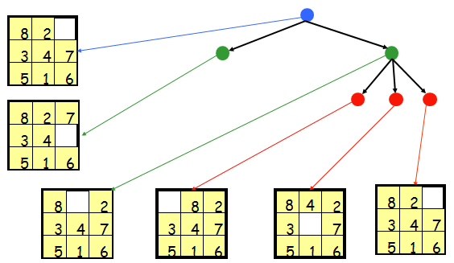
Search Nodes ≠ States
3.1 Introduction
3.2 Structure of problem solving agent
3.3 Steps in problem solving by problem solving agent
3.4 Problem Formulation
3.5 State-space Representation
3.6 Problem formulation of the Eight Tile Puzzle
3.7 Problem formulation of the Water Jug Problem
3.8 Difference between Conventional Problem and AI Problem
3.9 Searching
3.10 Features of problem
3.11 Types of Searches

Slide 40
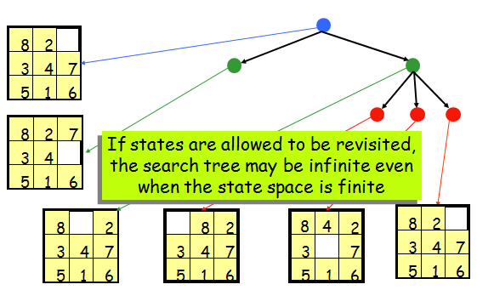
Search Nodes ≠ States
3.1 Introduction
3.2 Structure of problem solving agent
3.3 Steps in problem solving by problem solving agent
3.4 Problem Formulation
3.5 State-space Representation
3.6 Problem formulation of the Eight Tile Puzzle
3.7 Problem formulation of the Water Jug Problem
3.8 Difference between Conventional Problem and AI Problem
3.9 Searching
3.10 Features of problem
3.11 Types of Searches

Slide 41
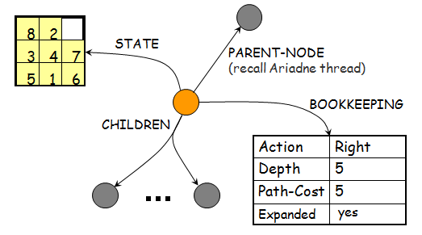
Data Structure of a Node
3.1 Introduction
3.2 Structure of problem solving agent
3.3 Steps in problem solving by problem solving agent
3.4 Problem Formulation
3.5 State-space Representation
3.6 Problem formulation of the Eight Tile Puzzle
3.7 Problem formulation of the Water Jug Problem
3.8 Difference between Conventional Problem and AI Problem
3.9 Searching
3.10 Features of problem
3.11 Types of Searches
Depth of a node N = length of path from root to N
(Depth of the root = 0)

Slide 42
Node expansion
3.1 Introduction
3.2 Structure of problem solving agent
3.3 Steps in problem solving by problem solving agent
3.4 Problem Formulation
3.5 State-space Representation
3.6 Problem formulation of the Eight Tile Puzzle
3.7 Problem formulation of the Water Jug Problem
3.8 Difference between Conventional Problem and AI Problem
3.9 Searching
3.10 Features of problem
3.11 Types of Searches
The expansion of a node N of the search tree consists of:
Evaluating the successor function on STATE(N)
Generating a child of N for each state returned by the function

Slide 43
Fringe and Search Strategy
3.1 Introduction
3.2 Structure of problem solving agent
3.3 Steps in problem solving by problem solving agent
3.4 Problem Formulation
3.5 State-space Representation
3.6 Problem formulation of the Eight Tile Puzzle
3.7 Problem formulation of the Water Jug Problem
3.8 Difference between Conventional Problem and AI Problem
3.9 Searching
3.10 Features of problem
3.11 Types of Searches
The fringe is the set of all search nodes that haven’t been expanded yet
8
2
Is it identical to the set of leaves?
3
4
7
5
1
6
8
2
7
3
4
5
1
6
8
2
8
2
8
4
2
8
2
3
4
7
3
4
7
3
7
3
4
7
5
1
6
5
1
6
5
1
6
5
1
6

Slide 44
Fringe and Search Strategy
3.1 Introduction
3.2 Structure of problem solving agent
3.3 Steps in problem solving by problem solving agent
3.4 Problem Formulation
3.5 State-space Representation
3.6 Problem formulation of the Eight Tile Puzzle
3.7 Problem formulation of the Water Jug Problem
3.8 Difference between Conventional Problem and AI Problem
3.9 Searching
3.10 Features of problem
3.11 Types of Searches
The fringe is the set of all search nodes that haven’t been expanded yet
It is implemented as a priority queue FRINGE
INSERT(node,FRINGE)
REMOVE(FRINGE)
The ordering of the nodes in FRINGE defines the search strategy

Slide 45
Search Algorithm
3.1 Introduction
3.2 Structure of problem solving agent
3.3 Steps in problem solving by problem solving agent
3.4 Problem Formulation
3.5 State-space Representation
3.6 Problem formulation of the Eight Tile Puzzle
3.7 Problem formulation of the Water Jug Problem
3.8 Difference between Conventional Problem and AI Problem
3.9 Searching
3.10 Features of problem
3.11 Types of Searches
If GOAL?(initial-state) then return initial-state
INSERT(initial-node,FRINGE)
Repeat:
If empty(FRINGE) then return failure
n ← REMOVE(FRINGE)
s ← STATE(n)
If GOAL?(s’) then return path or goal state
For every state s’ in SUCCESSORS(s)
Create a new node n’ as a child of n
INSERT(n’,FRINGE)

Slide 46
Performance Measures
3.1 Introduction
3.2 Structure of problem solving agent
3.3 Steps in problem solving by problem solving agent
3.4 Problem Formulation
3.5 State-space Representation
3.6 Problem formulation of the Eight Tile Puzzle
3.7 Problem formulation of the Water Jug Problem
3.8 Difference between Conventional Problem and AI Problem
3.9 Searching
3.10 Features of problem
3.11 Types of Searches
Completeness A search algorithm is complete if it finds a solution whenever one exists [What about the case when no solution exists?]
Optimality A search algorithm is optimal if it returns a minimum-cost path whenever a solution exists [Other optimality measures are possible]
Complexity It measures the time and amount of memory required by the algorithm

Slide 47
Important Parameters
3.1 Introduction
3.2 Structure of problem solving agent
3.3 Steps in problem solving by problem solving agent
3.4 Problem Formulation
3.5 State-space Representation
3.6 Problem formulation of the Eight Tile Puzzle
3.7 Problem formulation of the Water Jug Problem
3.8 Difference between Conventional Problem and AI Problem
3.9 Searching
3.10 Features of problem
3.11 Types of Searches
Maximum number of successors of any state → branching factor b of the search tree
Minimal length of a path between the initial and a goal state → depth d of the shallowest goal node in the search tree

Slide 48
Important Remark
3.1 Introduction
3.2 Structure of problem solving agent
3.3 Steps in problem solving by problem solving agent
3.4 Problem Formulation
3.5 State-space Representation
3.6 Problem formulation of the Eight Tile Puzzle
3.7 Problem formulation of the Water Jug Problem
3.8 Difference between Conventional Problem and AI Problem
3.9 Searching
3.10 Features of problem
3.11 Types of Searches
Some search problems, such as the (n²-1)-puzzle, are NP-hard
One can’t expect to solve all instances of such problems in less than exponential time
One may still strive to solve each instance as efficiently as possible

Slide 49
Features of problem
3.1 Introduction
3.2 Structure of problem solving agent
3.3 Steps in problem solving by problem solving agent
3.4 Problem Formulation
3.5 State-space Representation
3.6 Problem formulation of the Eight Tile Puzzle
3.7 Problem formulation of the Water Jug Problem
3.8 Difference between Conventional Problem and AI Problem
3.9 Searching
3.10 Features of problem
3.11 Types of Searches
Some of the main key features of a problem are listed as follows:
Is the problem decomposable into set of subproblems?
Can the solution step be ignored or undone?
Is the problem universally predictable?
Is a good solution to the problem obvious without comparison to all the possible solutions?
Is the desire solution a state of world or a path to a state?
Is a large amount of knowledge absolutely required to solve the problem?
Will the solution of the problem required interaction between the computer and the person?
Copyright © 2019 by Wiley India Pvt. Ltd., 4436/7, Ansari Road, Daryaganj, New Delhi-110002

Slide 50
Types of searches
3.1 Introduction
3.2 Structure of problem solving agent
3.3 Steps in problem solving by problem solving agent
3.4 Problem Formulation
3.5 State-space Representation
3.6 Problem formulation of the Eight Tile Puzzle
3.7 Problem formulation of the Water Jug Problem
3.8 Difference between Conventional Problem and AI Problem
3.9 Searching
3.10 Features of problem
3.11 Types of Searches
Uninformed Search/Blind Search :The search strategy, which has no information about the number of steps or path cost from the current state to goal state, but can only distinguish a goal state from a nongoal state is known as Uninformed search strategy or blind search strategy.
Informed Search: Strategies that know whether one non-goal state is more promising than the other is called as heuristic/ informed search techniques. The name means that this kind of search strategies are aware whether the search process is moving in the direction of goal or in the opposite direction of goal.
Copyright © 2019 by Wiley India Pvt. Ltd., 4436/7, Ansari Road, Daryaganj, New Delhi-110002

Slide 51

Dr. Nilakshi Jain Email ID : nilakshijain1986@gmail.com
Thank you

